Slide 1

Tutorial 6

Slide 2
Topic 1
What is the purpose of indexing?
Define the following terms: indexing field, primary key field, clustering field, secondary key field, and block pointer, and use them to explain three types of indexes.
Why can we have at most one primary or clustering index on a file, but several secondary indexes?

Slide 3
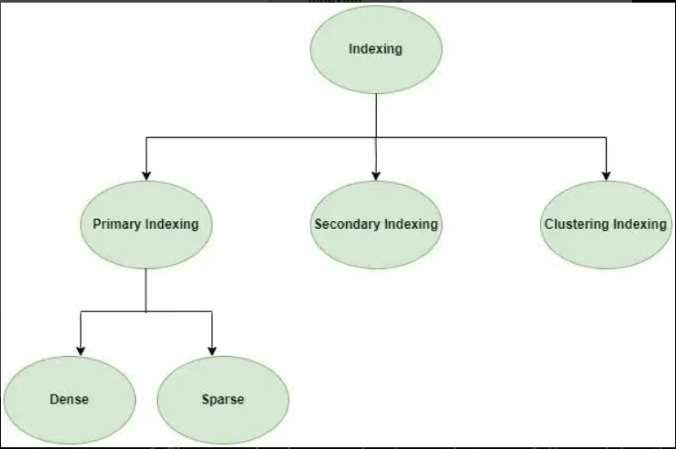

Slide 4
Topic 1
The purpose of indexing is to speed up data retrieval operations on a database. Without indexing, every search operation would require scanning the entire dataset, which is inefficient.

Slide 5
Topic 1
Indexing Field: The column on which the index is built.
Primary Key Field: A field that uniquely identifies a record within a table. No two records can have the same primary key value.
Clustering Field: The field on which records are physically ordered in the database storage medium.
Secondary Key Field: A field that is used for indexing but is not a primary key.
Block Pointer: A pointer indicating where a block of records can be found in the physical storage.

Slide 6
Topic 1
Types of Indexes
Primary Index:
Indexing Field: Typically, the primary key field of the database table.
Block Pointer: Points to the disk block containing the entire data record.
Explanation: Primary indexes are based on the primary key field and provide direct access to records based on their primary key values.

Slide 7
Topic 1
Types of Indexes
2.Clustering Index:
Clustering Field: Determines the physical order of records in the data file.
Block Pointer: Points to the disk block containing the record data or to the next block in the sequence.
Explanation: Clustering indexes organize records on disk based on the clustering field, allowing for efficient retrieval of sequentially ordered data.

Slide 8
Topic 1
Types of Indexes
3. Secondary Index:
Secondary Key Field: The indexed field other than the primary key.
Block Pointer: Points to the disk block containing the data records or to the next block in the sequence.
Explanation: Secondary indexes provide additional access paths to data based on fields other than the primary key, enabling faster retrieval for various types of queries.

Slide 9
Topic 1
Why Only One Primary or Clustering Index but Multiple Secondary Indexes?
Primary or Clustering Index: Since this type of index determines the physical order of records in storage, you can only have one per table. Having more than one would mean the data would need to be stored in multiple ways, which is not possible.
Secondary Indexes: These indexes are separate from the data, so you can have as many as you like to improve the performance of different kinds of queries. They do not affect the physical ordering of data.

Slide 10
Topic 2
Discuss why concurrency control is needed, and list two kinds of update problems. Discuss why recovery is needed.

Slide 11
Topic 2
Why is Concurrency Control Needed?

Slide 12
Topic 2
Why is Concurrency Control Needed?
Concurrency control is essential in multi-user and multi-transaction database environments to maintain consistency and integrity of the data. When multiple transactions are executed concurrently, without controls, they can interfere with each other, leading to various types of inconsistencies.
Two Kinds of Update Problems:
Lost Update Problem: This occurs when two transactions read the same data item and update it simultaneously. One transaction's update could overwrite the other's, causing the system to lose information.
Temporary Update (or Dirty Read) Problem: In this case, one transaction updates a data item but hasn't yet committed the change. A second transaction reads the temporary, "dirty" data and uses it for further processing. If the first transaction then rolls back, the second transaction will have read inconsistent data.

Slide 13
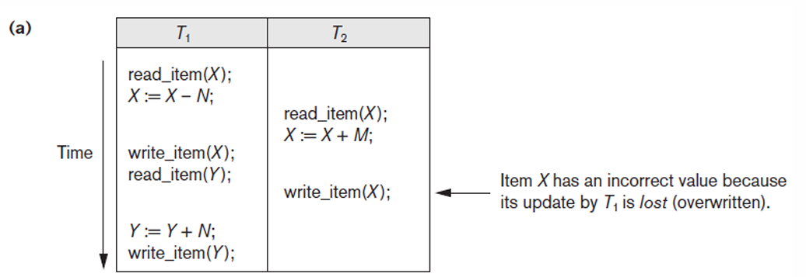
Topic 2
Lost Update Problem

Slide 14
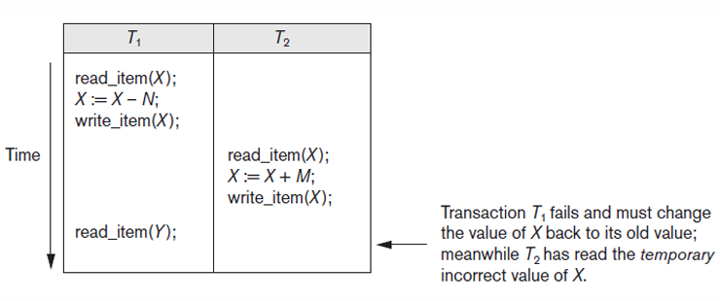
Topic 2
2. Temporary Update (or Dirty Read) Problem

Slide 15
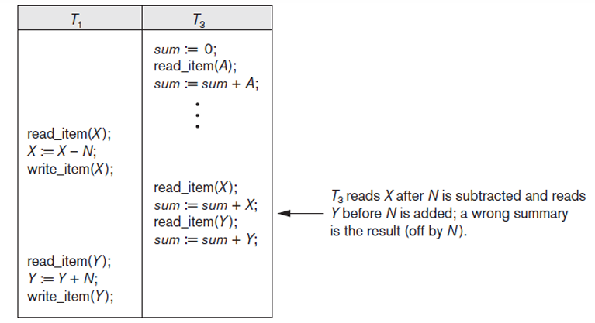
Topic 2
3. The Incorrect Summary Problem

Slide 16
Topic 2
Why is Recovery Needed?

Slide 17
Topic 2
Why is Recovery Needed?
Recovery mechanisms are essential to bring the database back to a consistent state after a failure. Failures can be due to various reasons like system crashes, hardware failures, or even software bugs. Without a recovery system in place, these failures can result in data loss or inconsistencies.
Types of Recovery Mechanisms:
Immediate Update: Changes are written to disk before the transaction commits. This requires a "redo" and "undo" log to recover from failures.
Deferred Update: Changes are only written to disk after the transaction reaches a commit point. In this case, only a "redo" log is required.

Slide 18
Topic 3
What is the system log used for? What kind of information needs to be recorded in the system log?

Slide 19
Topic 3
What is the System Log Used For?
A system log is used for recording events, transactions, and operations that occur within a database management system (DBMS) or any other software system. The primary purposes of a system log in the context of a database include:
Audit Trail: To keep track of who did what and when, for accountability and security reasons.
Debugging and Troubleshooting: To identify the source of errors or performance issues.
Recovery: To restore the database to a consistent state after system failures, crashes, or errors.
Concurrency Control: To help resolve conflicts between concurrent transactions.

Slide 20
Topic 3
Kind of Information Recorded in the System Log
The type of information recorded in the system log can vary based on system configuration and needs, but generally, it includes:
Transaction Identifiers: A unique ID to distinguish each transaction.
Timestamps: When each transaction or operation occurred.
Operation Type: What kind of operation was performed (e.g., read, write, update, delete).
Data Items: Details of the data that was accessed or modified.
User Information: Who initiated the transaction or operation.
Before and After Images: The state of data before and after modification, useful for "undo" and "redo" operations during recovery.
Commit/Rollback Flags: Indicators of whether a transaction has been committed or rolled back.
Lock Information: Details of locks acquired or released, useful for concurrency control.
Error Messages: Any errors or exceptions that occurred during the operation.

Slide 21
Topic 4
Discuss the atomicity, durability, isolation, and consistency preservation properties of a database transaction.

Slide 22
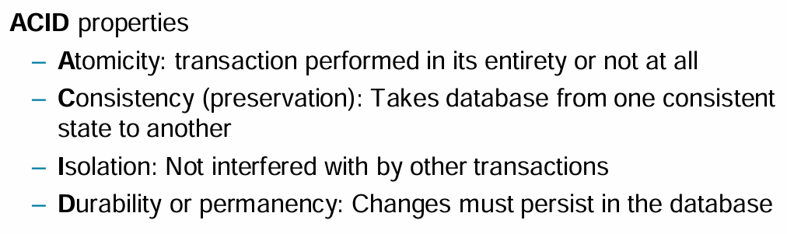
Topic 4
Discuss the atomicity, durability, isolation, and consistency preservation properties of a database transaction.

Slide 23
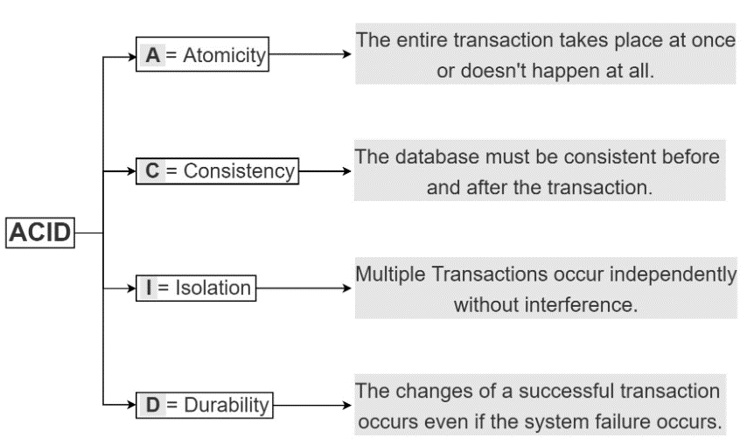
Topic 4
Discuss the atomicity, durability, isolation, and consistency preservation properties of a database transaction.

Slide 24
Topic 5
What is a serial schedule? What is a serializable schedule? Why is a serializable schedule considered correct? Show examples of a serializable schedule and a non-serializable schedule.

Slide 25
Topic 5
What is a Serial Schedule?
A serial schedule is a sequence of transactions in a database where the operations of each transaction are executed consecutively without any overlap with operations from other transactions. In other words, one transaction must complete all its operations before the next transaction begins. Serial schedules are straightforward and naturally maintain database consistency but can be inefficient in multi-user environments because they don't exploit parallelism.

Slide 26
Topic 5
What is a Serializable Schedule?
A serializable schedule is a schedule where transactions can have interleaved operations but the outcome (or effect on the database) is the same as if the transactions were executed in some serial order. Serializable schedules are important because they maintain the database's consistency while allowing for more efficient concurrent transaction execution.
Why is a Serializable Schedule Considered Correct?
A serializable schedule is considered correct because it preserves the consistency of the database, just like a serial schedule. However, it allows for concurrent execution of transactions, thereby increasing system throughput and reducing wait times.

Slide 27
Topic 5
Serializable Schedule
Let's consider two transactions T1 and T2:
T1: READ(A); A = A - 50; WRITE(A);
T2: READ(A); A = A * 1.1; WRITE(A);

Slide 28
Topic 5
Serializable Schedule
Let's consider two transactions T1 and T2:
T1: READ(A); A = A - 50; WRITE(A);
T2: READ(A); A = A * 1.1; WRITE(A);
A serializable schedule could be:
READ(A) [T1], A=A-50 [T1], WRITE(A) [T1], READ(A) [T2], A=A*1.1 [T2], WRITE(A) [T2]
This is serializable because it's equivalent to the transactions being executed in the order T1, then T2 (or vice versa), both of which are serial schedules.

Slide 29
Topic 5
Non-Serializable Schedule
Consider the same transactions T1 and T2:
T1: READ(A); A = A - 50; WRITE(A);
T2: READ(A); A = A * 1.1; WRITE(A);
A non-serializable schedule could be:
READ(A) [T1], READ(A) [T2], A=A-50 [T1], A=A*1.1 [T2], WRITE(A) [T2], WRITE(A) [T1]
This is non-serializable because the interleaving produces a result that is not equivalent to any serial execution of T1 and T2. The operations from T2 use stale data and overwrite the changes made by T1.

Slide 30
Topic 6
For the following schedules which involve three transactions (where ri(x) means that transaction i reads item x, wi(x) means that transaction i writes item x, and ci means that transaction i commits), check the serializability of these schedules and explain the reason.
(1) r1(x), r2(x), w1(x), r1(y), r3(z), r2(y), c1, r3(x), w3(x), r2(z), c2, r3(y), c3
(2) r1(x), r2(x), w2(x), r2(y), r3(z), r1(y), r3(x), w1(y), r2(z), c1, c2, r3(y), c3
Notes:
(1) Serializable, T2→T1, T2→T3, T1→T3, no cycles among T1, T2, T3.
(2) Non-serializable, T1→T2, T1→T3, T2→T1, T2→T3, one cycle between T1 and T2.

Slide 31
Topic 6
To check the serializability of schedules, one common approach is to construct a precedence graph (also called a serializability graph). The vertices represent transactions, and a directed edge from Ti to Tj means that Ti must be executed before Tj to preserve the consistency of the database.

Slide 32
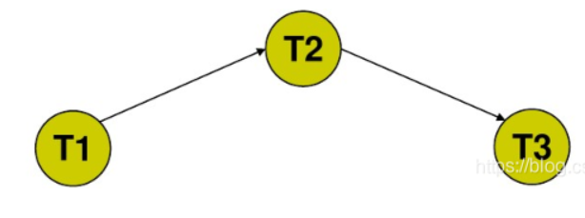
Topic 6
To check the serializability of schedules, one common approach is to construct a precedence graph (also called a serializability graph). The vertices represent transactions, and a directed edge from Ti to Tj means that Ti must be executed before Tj to preserve the consistency of the database.

Slide 33
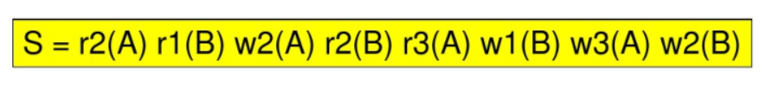
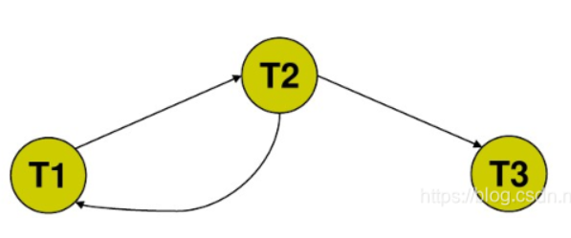
Topic 6
To check the serializability of schedules, one common approach is to construct a precedence graph (also called a serializability graph). The vertices represent transactions, and a directed edge from Ti to Tj means that Ti must be executed before Tj to preserve the consistency of the database.

Slide 34
Topic 6
Schedule 1
r1(x), r2(x), w1(x), r1(y), r3(z), r2(y), c1, r3(x), w3(x), r2(z), c2, r3(y), c3
There's an edge from T2 to T1 because r2(x) appears before w1(x).
There's an edge from T2 to T3 because r2(x) appears before w3(x).
There's an edge from T1 to T3 because w1(x) appears before r3(x).
Serializable, T2→T1, T2→T3, T1→T3, no cycles among T1, T2, T3.

Slide 35
Topic 6
Schedule 2
r1(x), r2(x), w2(x), r2(y), r3(z), r1(y), r3(x), w1(y), r2(z), c1, c2, r3(y), c3
There is a directed edge from T1 to T2 because r1(x) comes before w2(x).
There is a directed edge from T2 to T1 because r2(y) comes before w1(y).
There is a directed edge from T1 to T3 because w1(y) comes before r3(y).
There is a directed edge from T2 to T3 because w2(x) comes before r3(x).
Non-serializable, T1→T2, T1→T3, T2→T1, T2→T3, one cycle between T1 and T2.

Slide 36
Topic 7
Briefly explain the two-phase locking (2PL) protocol. What is the purpose of this protocol?

Slide 37
Topic 7
The Two-Phase Locking (2PL) protocol is a concurrency control method used in database management systems to ensure serializability. It is called "two-phase" because the lifetime of each transaction is divided into two distinct phases:
Growing Phase: A transaction can acquire any number of locks needed but cannot release any.
Shrinking Phase: A transaction can release locks but cannot acquire any new ones.
The point where a transaction moves from the growing phase to the shrinking phase is called the "lock point."

Slide 38
Topic 7
Purpose:
The primary purpose of 2PL is to ensure a schedule is conflict-serializable, which means it can be transformed into a serial schedule by swapping non-conflicting operations. By adhering to 2PL, the system avoids scenarios that can lead to non-serializable schedules, thereby ensuring data integrity and consistency.
2PL prevents phenomena like lost updates, temporary inconsistency, and uncommitted data, which can occur in a concurrent environment. However, it's worth noting that while 2PL ensures conflict-serializability, it doesn't prevent deadlocks or guarantee freedom from cascading rollbacks.

Slide 39
Notes:
Figure 21.3 Transactions That Do Not Obey Two-Phase Locking (a) Two Transactions T1 and T2 (b) Results of Possible Serial Schedules of T1 and T2 (c) A NonserializableSchedule SThat Uses Locks

Slide 40
In database systems that use Two-Phase Locking (2PL), it's important for transactions to adhere to the 2PL protocol to ensure serializability. However, you can have transactions that do not obey 2PL. Such transactions could lead to non-serializable schedules, meaning they can produce a result that is not equal to any serial execution of the transactions.
Example Explanation
Two Transactions T1 and T2: You have two transactions, T1 and T2, that read and write to the same data items.
Possible Serial Schedules of T1 and T2: If you execute T1 followed by T2 or T2 followed by T1 without any overlap, these are serial schedules. They guarantee consistency but may not be efficient.
A Non-Serializable Schedule That Uses Locks: Now, consider a schedule where T1 and T2 overlap but do not adhere to the 2PL protocol. For example, T1 may release a lock before reaching its lock point, allowing T2 to read a value it shouldn't, and then re-acquire the lock. This could lead to a result that does not match any serial execution of T1 and T2, making the schedule non-serializable.

